Slide 1
Build a Serverless Web Application with AWS Lambda, Amazon API Gateway, AWS Amplify, Amazon DynamoDB, and Amazon Cognito

Slide 2
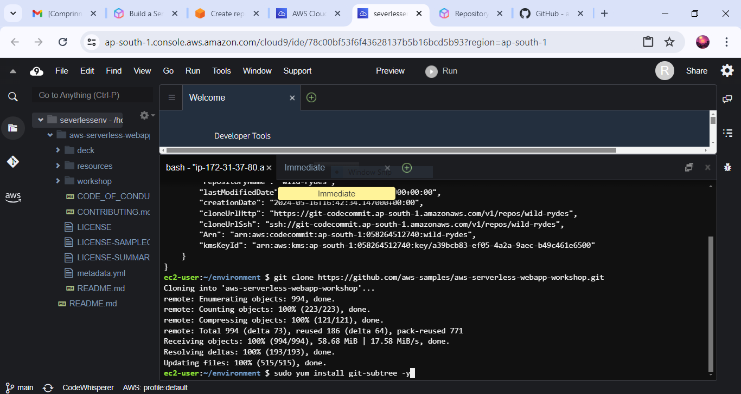
1.download the Repository using AWS CodeCommit console.

Slide 3
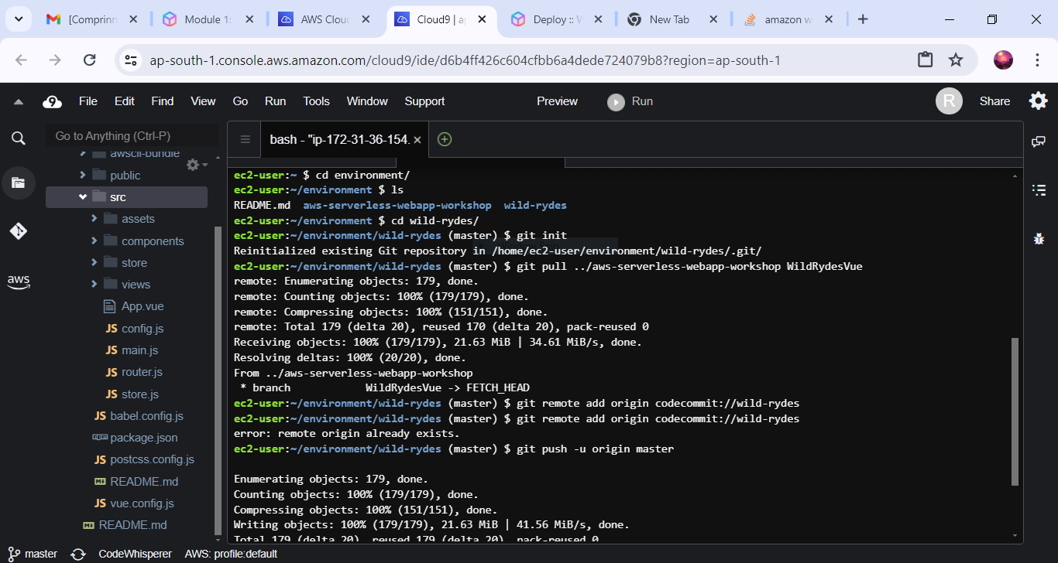
2. Copy the source code to New Repository

Slide 4
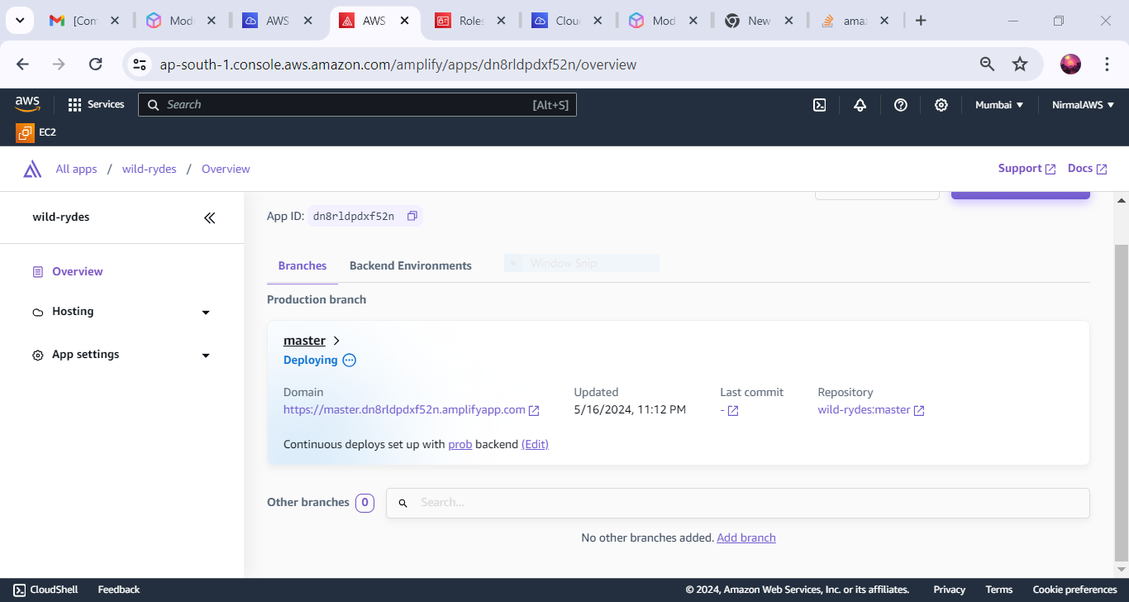
3.Run the application using AWS Amplify

Slide 5
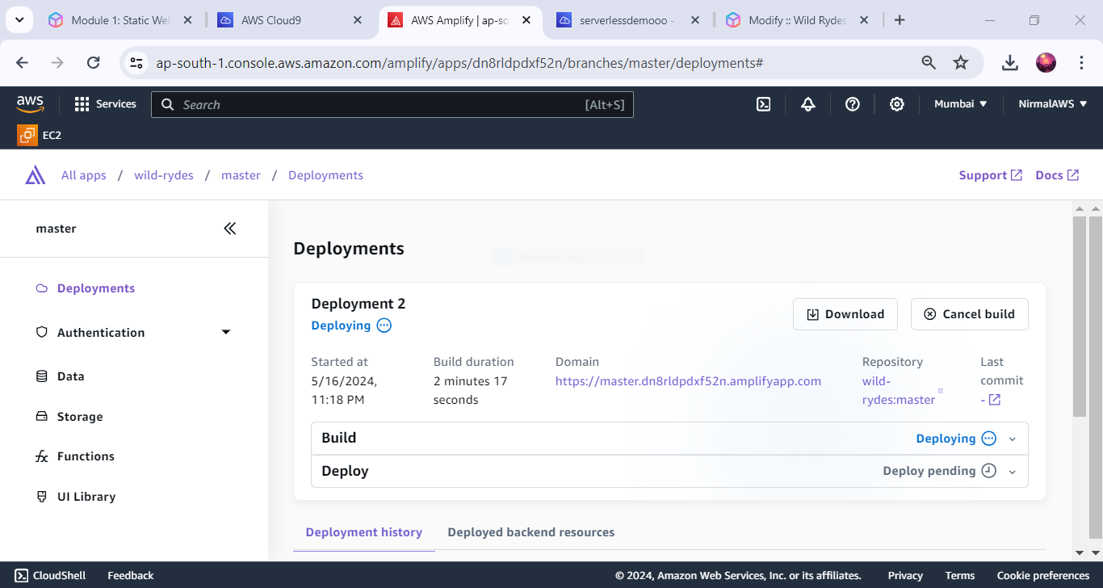
4.Deploy the Application on AWS amplify

Slide 6
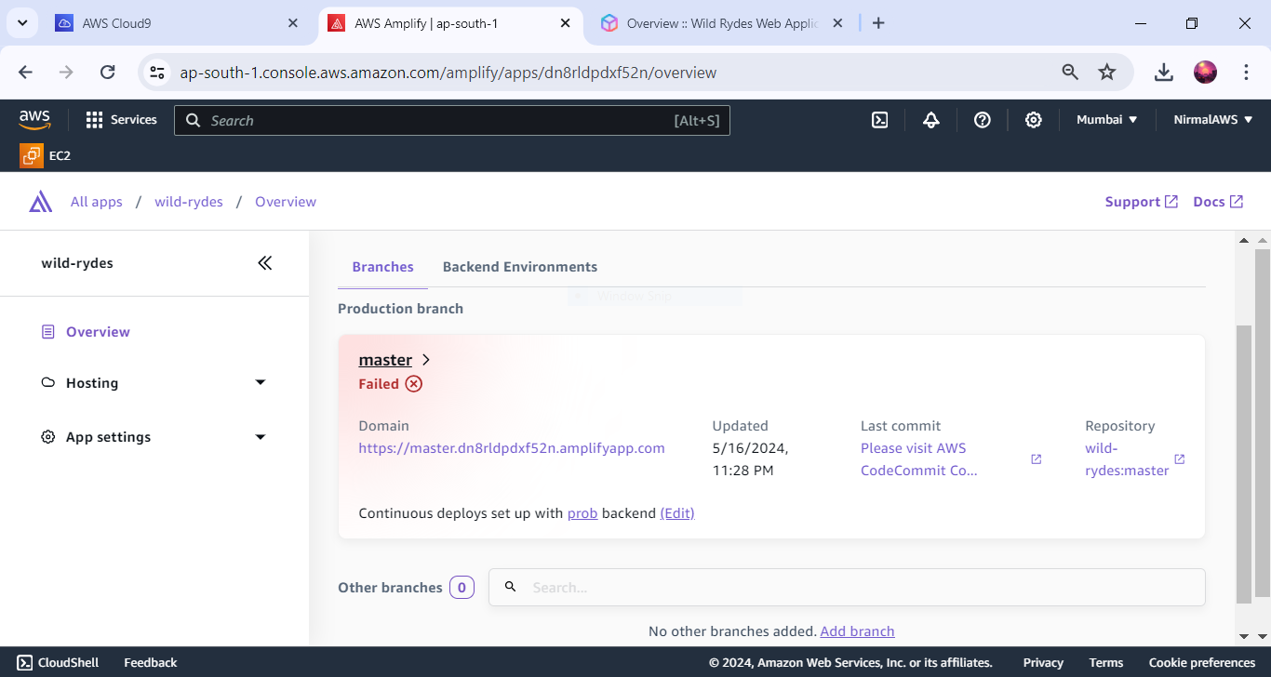
5.Got Error during deployment

Slide 7
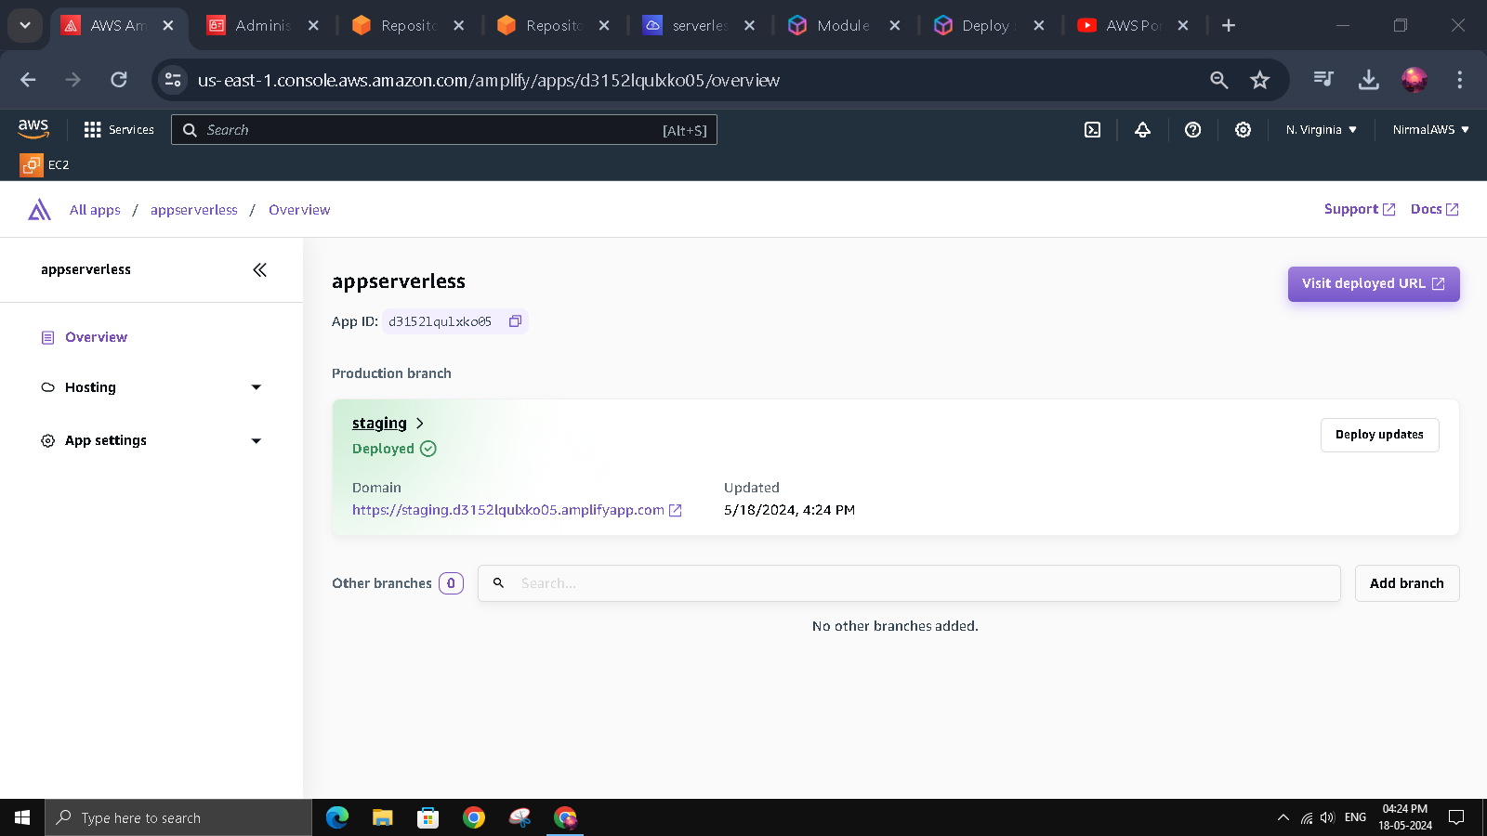
7.depoyment successful

Slide 8
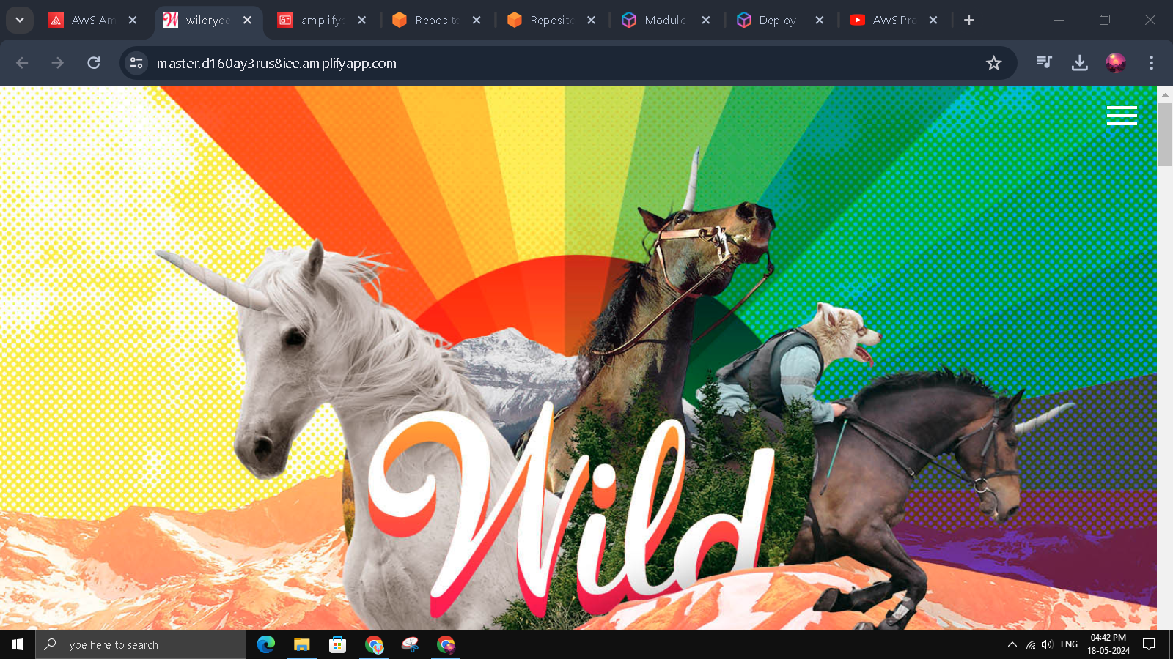
8.Deployed Static app using the Amplify

Slide 9
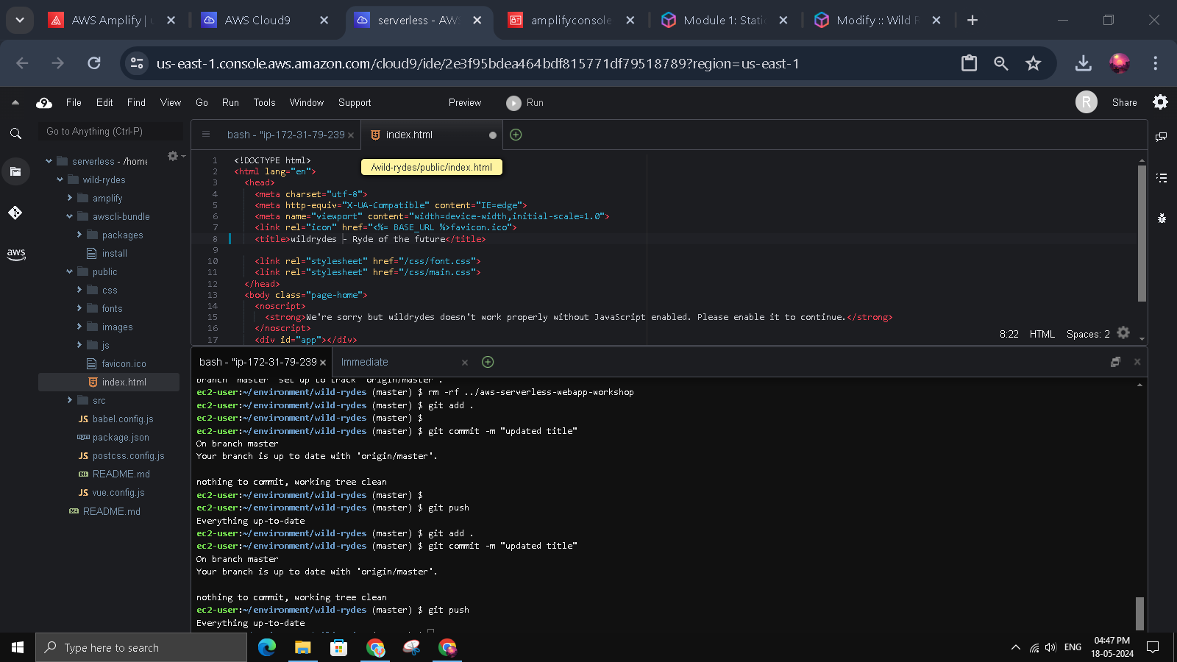
9.configure the index.html to check continuous deployment

Slide 10
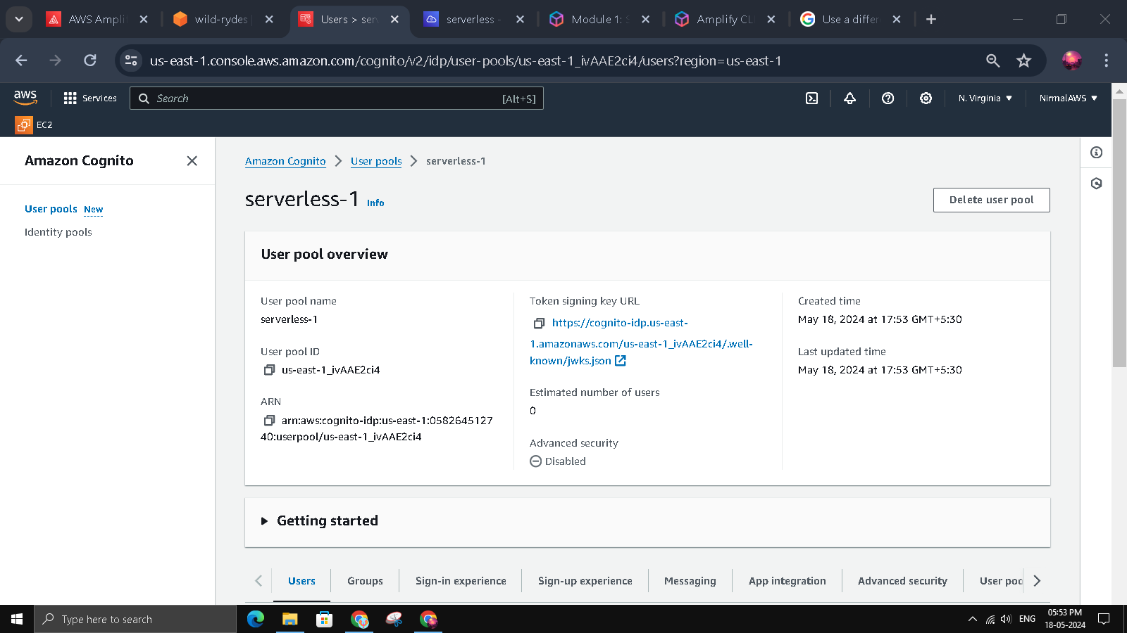
10.create pods in cognito to create the Authentication

Slide 11
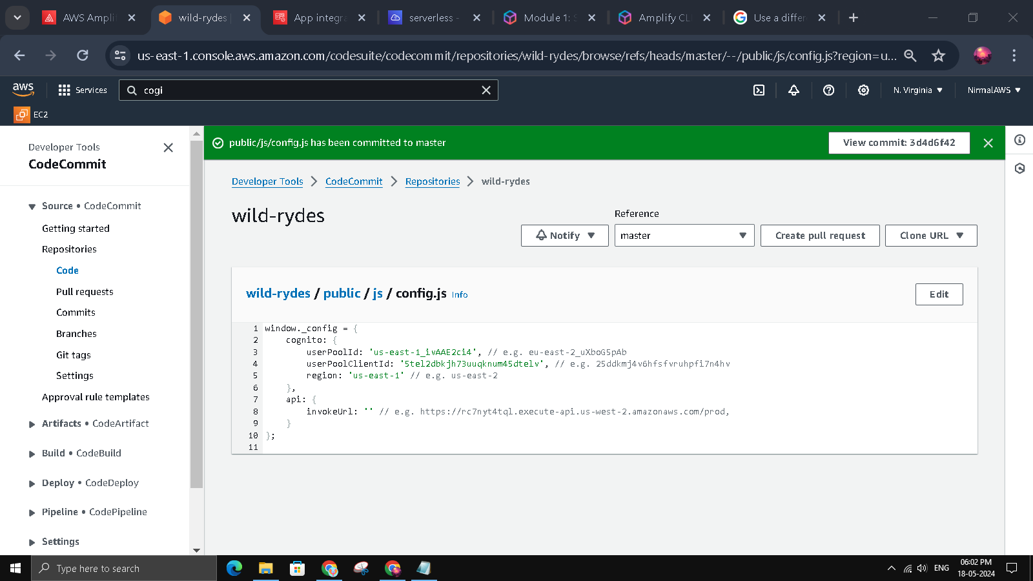
11.configure the code in codecommit to access cognito

Slide 12
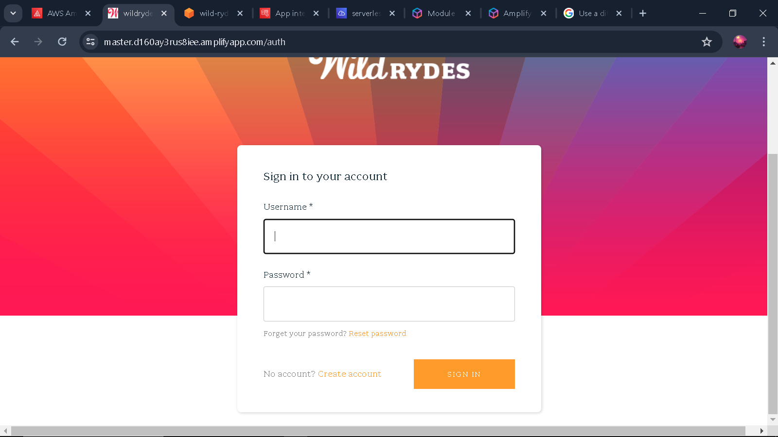
12.authenticationpage is deployed

Slide 13
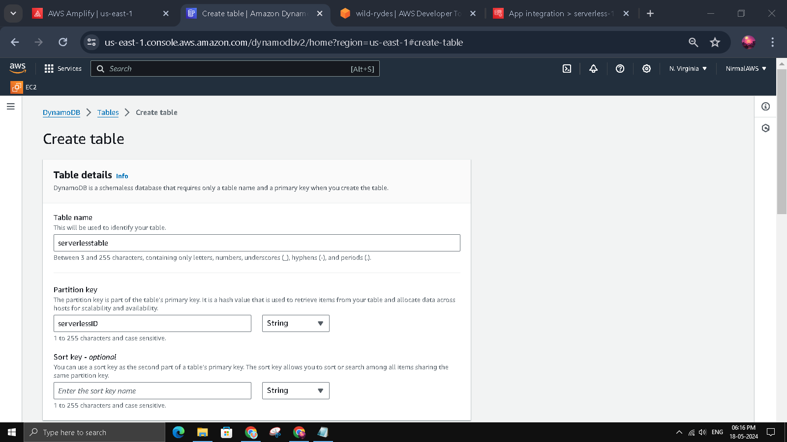
13.create table using DynamoDB

Slide 14
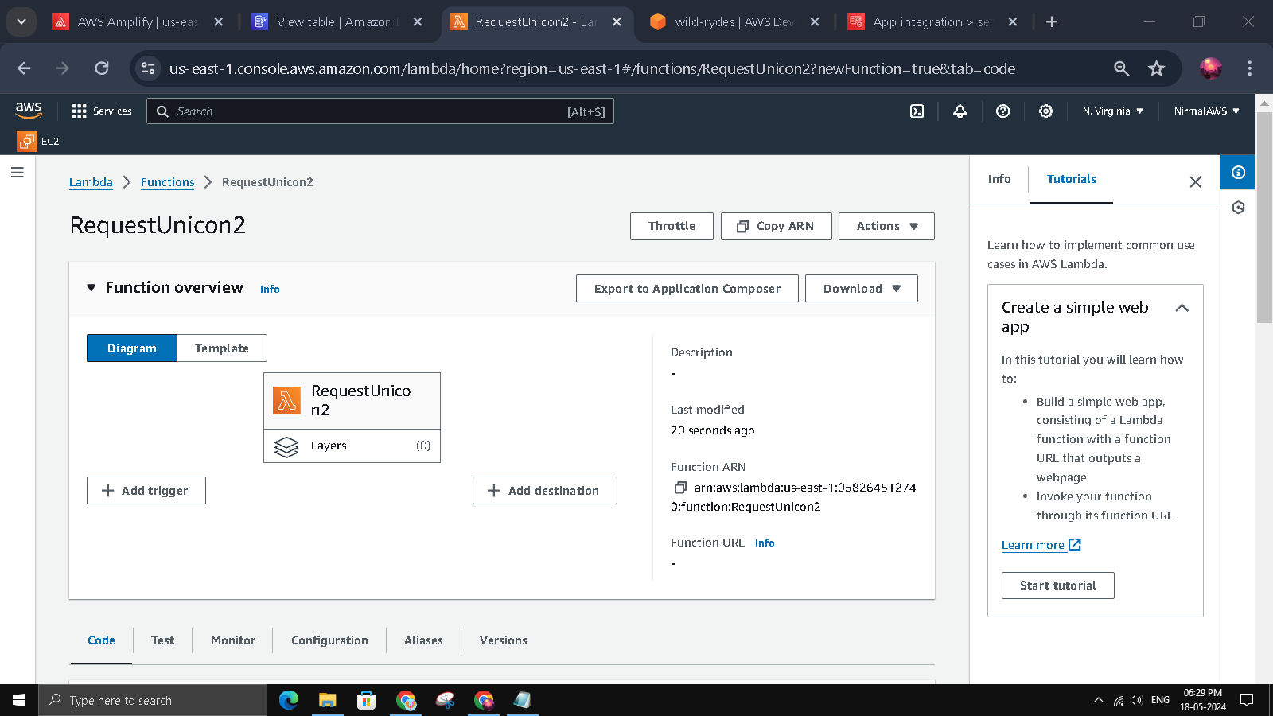
14.create lambdaFunction

Slide 15
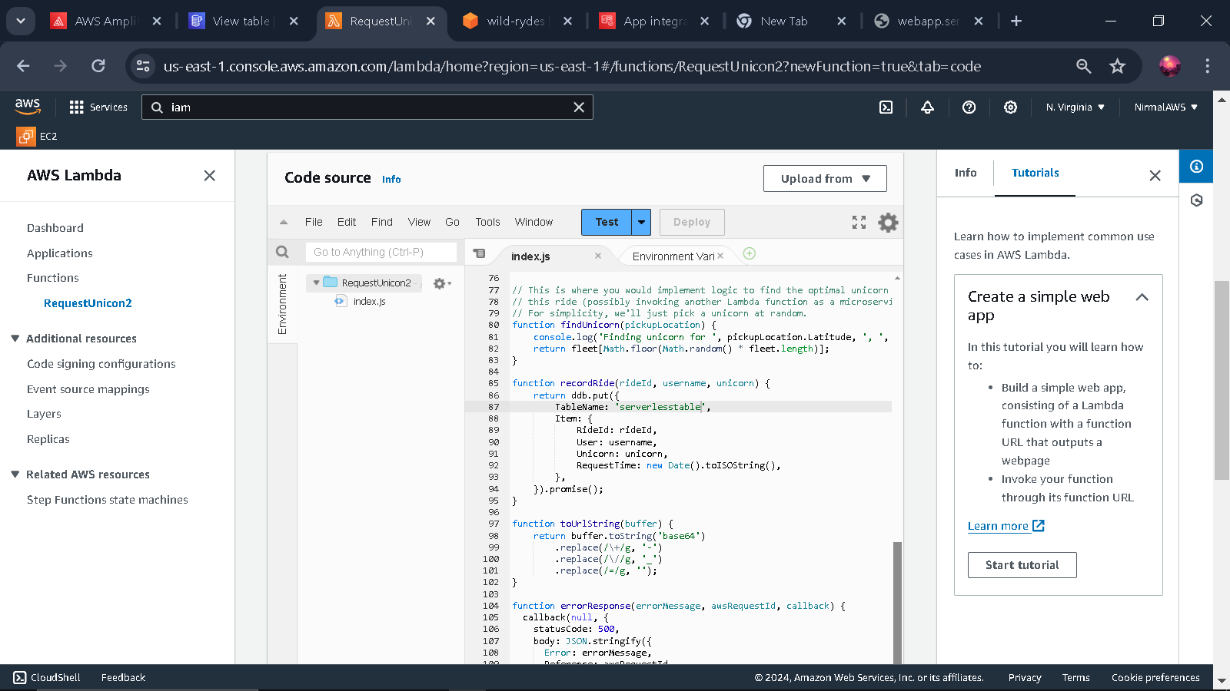
15.connect the Dynamo DB from index.js

Slide 16
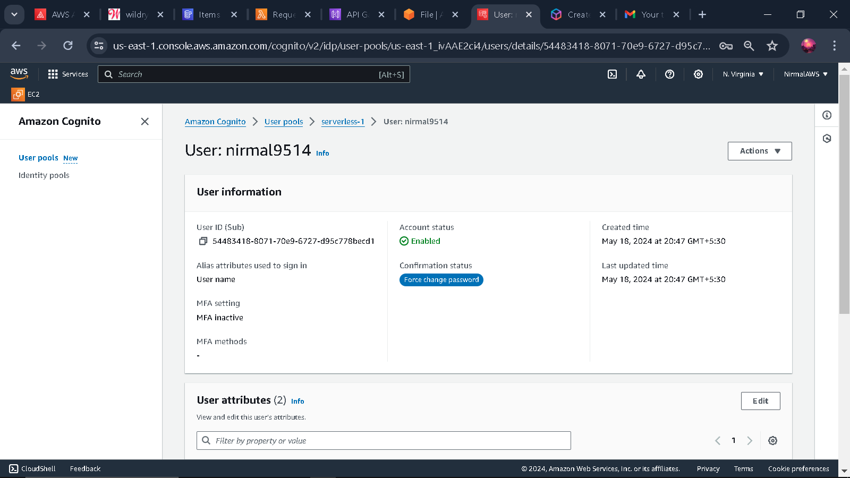
16.user is added in AWS cognito

Slide 17
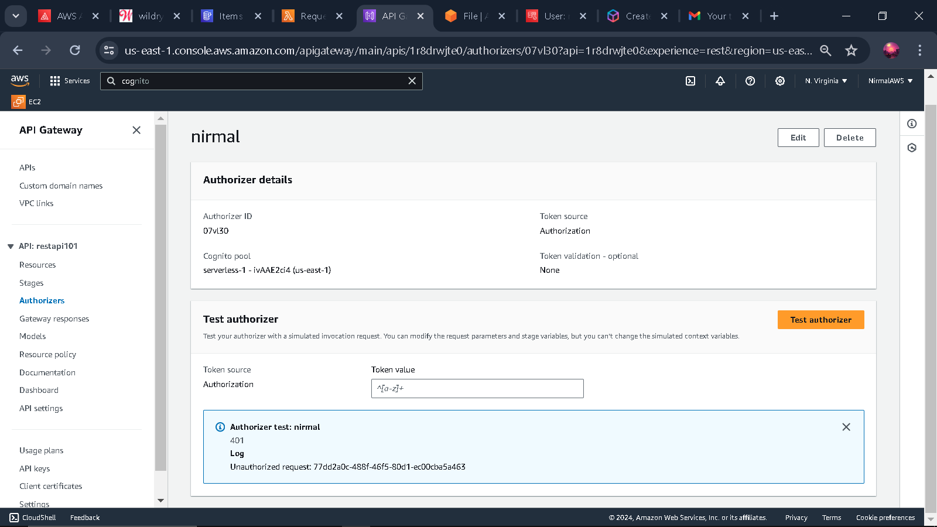

Slide 18
